Slide 1
CST205: OBJECT ORIENTED PROGRAMMING USING JAVA
Module 2
Core Java Fundamentals

Slide 2
Class Fundamentals
The class is the core of Java.
The class forms the basis for object-oriented programming in Java.
A class is a "blueprint" for creating objects
A class is a template for an object.
Object is an instance of a class.
A class defines a new type of data.
A class creates a logical framework that defines the relationship between its members.

Slide 3
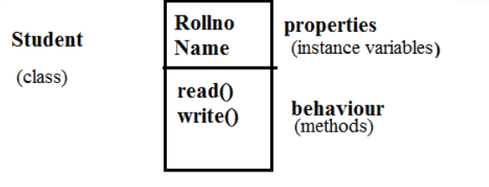
Eg:

Slide 4
A class is declared using the keyword class
The data or variables, defined within a class are called instance variables.
because each instance of the class (ie,each object of the class) contains its own copy of these variables.
the data for each object is separate and unique.
Functions inside class are called methods.
The methods and variables defined within a class are called members of the class.

Slide 5
The General Form of a Class
• A general form of a class definition is
class classname
{
type instance-variable1 ;
type instance-variable;
type methodname1(parameter-list)
{
// body of method
}
type methodnameN(parameter-list)
{
// body of method
}
Properties
(instance
variables)
Behaviour or Method or Function
Members of Class
Behaviour or Method or Function

Slide 6
A Simple Class
class Box
{
double length;
double width;
double height;
}
void volume()
{
//statements
}
}
Properties
(instance
variables)
Members of Class
Behaviour or Method or Function

Slide 7
Declaring Objects
• When we create a class, we are creating a new data type.
— We can use this type to declare objects of that type.
• Obtaining objects of a class is a two-step process.
— First, we must declare a variable of the class type.
• This variable does not define an object.
• It is simply a variable that can refer to an object.
— Second, we must acquire an actual, physical copy of the object and assign it to that variable (using new operator)

Slide 8
Classname objectname ; // declare reference to object
objectname = new Classname(); // allocate an object
• We can write this in a single statement
Classname objectname = new Classname();

Slide 9
class Box{
double length;
double width;
double height;
}
Box mybox;
• This line declares mybox as a reference to an object of type Box. Here mybox contains the value null, which indicates that it does not yet point to an actual object
mybox = new Box();
• This line allocates an actual object and assigns a reference to it to mybox. mybox holds the memory address of the actual Box object.

Slide 10
class Box{
double length;
double width;
double height;
}
Box mybox;
mybox = new Box();
null
mybox
length
width
mybox
height
Box object

Slide 11
The class name followed by parentheses specifies the constructor for the class.
Box mybox = new Box();
Here Box is the class. Box()is the constructor.
A constructor defines what occurs when an object of a class is created.

Slide 12
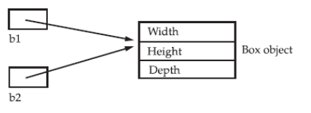
Assigning Object Reference Variables
• Object reference variables act differently when an assignment takes place
• E.g.
Box b1 = new Box();
Box b2 = b1;
• Here bl and b2 will both refer to the same object.
• Any changes made to the object through b2 will affect the object which is referred by b1 , because they are the same object.

Slide 13
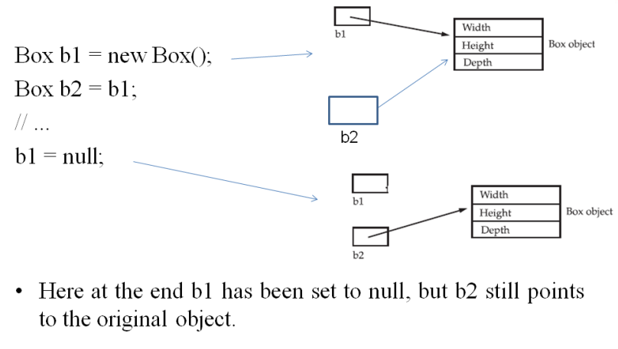

Slide 14
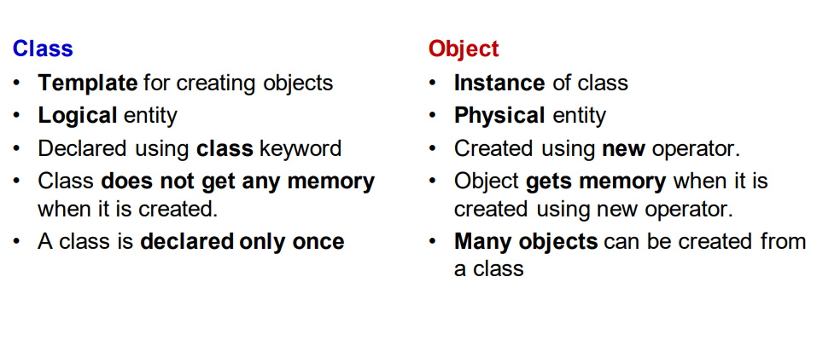

Slide 15
Introducing Methods The general form of a method:
type name(parameter-list)
{
//body of method
}
Methods that have a return type other than void return a value to the calling routine
Syntax :
return value;
The type specifies the type of data returned by the method.
The parameter-list or argument list is a sequence of type and identifier pairs separated by commas.

Slide 16
• Create a class Box with instance variables length, width and height. Include a method volume to compute the volume of the box.
• Create another class BoxDemo with main function that creates an object of class Box named mybox1 and set the values for instance variables(length, width and height).Invoke the function volume in Box to compute the volume of the created object mybox1.

Slide 17
Algorithm
Start
Create a class Box with instance variables length, width and height and method volume() that returns volume.
Create another classes BoxDemo with the main function. Inside the main function do the steps 4 to 6.
Create an object of Box mybox1 class and assign appropriate values to the variables.
Invoke the function volume() using object .
Print the value of volume
End

Slide 18
class Box
{
double length;
double width;
double height;
void volume()
{
double vol=length*width* height;
System.out.println("Volume="+vol);
}
}
class BoxDemo
{
public static void main(String[] args)
{
Box mybox1 =new Box();
mybox1.length=10;
mybox1.width=20;
mybox1. height =30;
mybox1.volume();
}
}

Slide 19
Modify the program using return statement
class Box{
double length;
double width;
double height;
double volume()
{
double vol=length*width* height;
return vol;
}
}
class BoxDemo {
public static void main(String[] args)
{
Box mybox1 =new Box();
mybox1.length=10;
mybox1.width=20;
mybox1. height =30;
double v=mybox1.volume();
System.out.println("Volume="+v);
}
}

Slide 20
Modify the program to take input from user
import java. util. Scanner;
class Box
{
double length;
double width;
double height;
double volume()
{
double vol=length*width*height;
return vol;
}
}

Slide 21
class BoxDemo
{
public static void main(String[] args)
{
Scanner sc=new Scanner (System. in) ;
Box mybox1=new Box();
System.out.println ("Enter length, width , height ");
mybox1.length=sc.nextDouble ( ) ;
mybox1.width=sc.nextDouble ( ) ;
mybox1.height=sc.nextDouble ( ) ;
double v=mybox1.volume();
System.out.println("Volume="+v);
}
}

Slide 22
1.Create a class Box with instance variables length, width and height. Calculate volume using methods with return type
import java. util.Scanner;
class Rectangle
{
double length;
double breadth;

Slide 23
double getArea()
{
double area = length*breadth;
return area;
}
double getPerimeter()
{
double perimeter = 2 * (length+breadth);
return perimeter;
}
}

Slide 24
class RectDemo {
public static void main(String[] s) {
Scanner sc=new Scanner(System.in);
Rectangle rect = new Rectangle();
System.out.println("Enter length of rectangle");
rect.length=sc.nextDouble();
System.out.println("Enter breadth of rectangle");
rect.breadth=sc.nextDouble();
System.out.println("Area of rectangle:" + rect.getArea());
System.out.println("Perimeter of rectangle:"
+ rect.getPerimeter());
} }

Slide 25
Constructor
A constructor help to initialize an object(give values) immediately upon creation.
Constructor is a special method inside the class.
Constructor has the same name as the class in which it resides.
Once defined, the constructor is automatically called immediately after the object is created, before the new operator completes.

Slide 26
• The constructor name must match the class name, and it cannot have a return type
If there is no constructor in a class, compiler automatically creates a default constructor.
• All classes have constructors by default
• If you do not create a class constructor yourself, Java creates one for you. Then you are not able to set initial values for object attributes.
Notes:
This is because the implicit return type of a class' constructor is the class type itself.

Slide 27
• Two types of constructors
Default constructor
Parameterized constructor

Slide 28
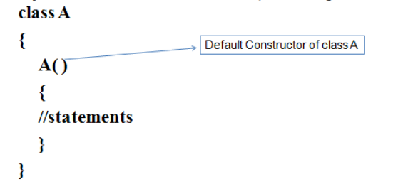
Default constructor
Default constructor has no arguments or parameters.
• When a constructor is not explicitly defined for a class, Java creates a default constructor for the class.
• The purpose of a default constructor is to provide the default values to the object like 0, null, etc., depending on the type.
Eg:

Slide 29
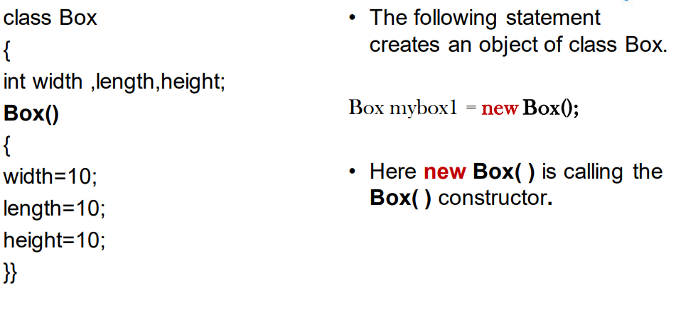

Slide 30
class Box
{
double length;
double width;
double height;
Box()
{
System.out.println("Inside Constructor");
length=10;
width=20;
height=30;
}
double volume()
{
double vol=length*width* height;
return vol;
}
}
class BoxDemo
{
public static void main(String[] args)
{
Box mybox1 =new Box();
Box mybox2 =new Box();
double v;
v=mybox1.volume();
System.out.println("volume is="+v);
v=mybox2.volume();
System.out.println("volume is="+v);
}
}

Slide 31
class Box
{
double length;
double width;
double height;
Box()
{
System.out.println("Inside Constructor");
length=10;
width=20;
height=30;
}

Slide 32
double volume()
{
double vol=length*width* height;
return vol;
}
}
class BoxDemo
{
public static void main(String[] args)
{
Box mybox1 =new Box();
Box mybox2 =new Box();
double v;
v=mybox1.volume();
System.out.println("volume is="+v);
v=mybox2.volume();
System.out.println("volume is="+v);
}
}

Slide 33
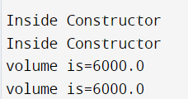
Output

Slide 34
Parameterized Constructors
Constructors with arguments are called parameterized constructors.
class Box
{
double width;
double height;
double length;
Box(double w, double h, double l)
{
width = w;
height = h;
length= l;
}

Slide 35
double volume(){
return(width * height * length);
}
}
class BoxDemo {
public static void main(String args[]) {
Box mybox1=new Box(10, 20, 15);
Box mybox2= new Box(3, 6, 2);
double vol;
vol= mybox1.volume();
System.out.println("Volume is " + vol);
vol= mybox2.volume();
System.out.println("Volume is " + vol);
}
}

Slide 36
Box mybox1 = new Box(10, 20, 15);
Here the values 10, 20, and 15 are passed to the Box( )
constructor when new creates the object mybox1 .

Slide 37
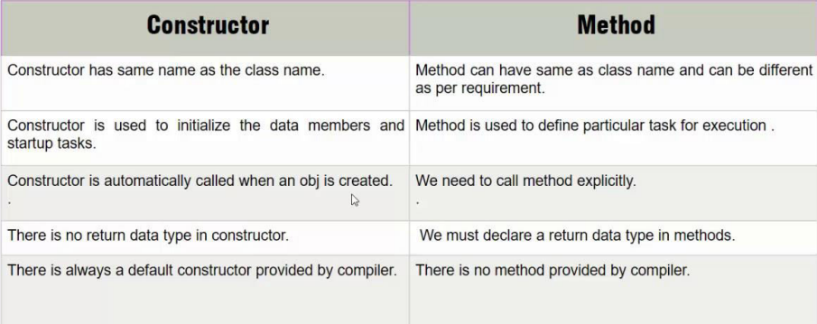

Slide 38
this keyword
The this keyword can be used inside any method to refer to the current object.
this is always a reference to the object on which the method was invoked.
this can be used to refer current class instance variable.
this can be used to invoke current class method (implicitly)
this() can be used to invoke current class constructor.
this can be passed as an argument in the method call.
this can be passed as argument in the constructor call.

Slide 39
Box(double w, double h, double l)
this.width = w;
this.height = h;
this.length = l;
Here this will always refer to the object invoking the method

Slide 40
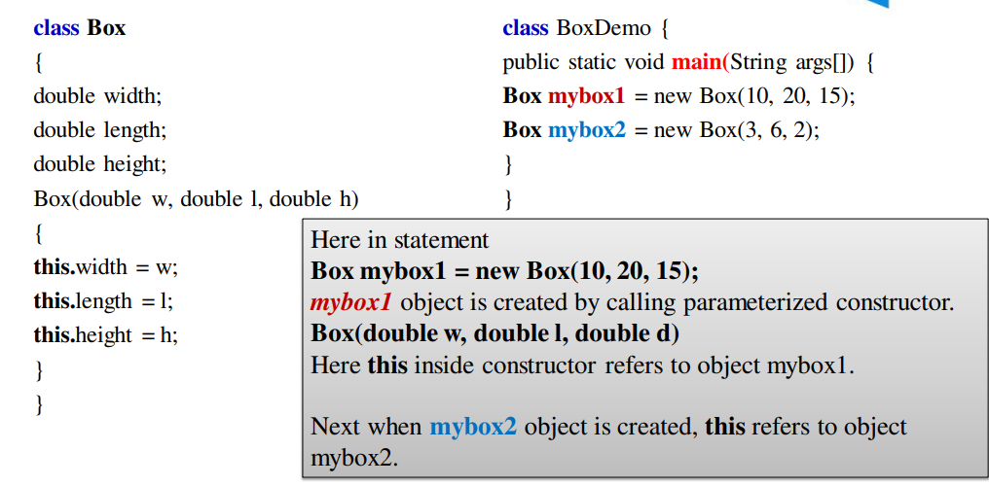

Slide 41
Instance variable hiding-using this
We can have local variables, including formal parameters to methods, which has the same name of the class instance variables(attributes).
When a local variable has the same name as an instance variable, the local variable hides the instance variable.
this helps to solve the issue
Use this. along with instance variables.

Slide 42
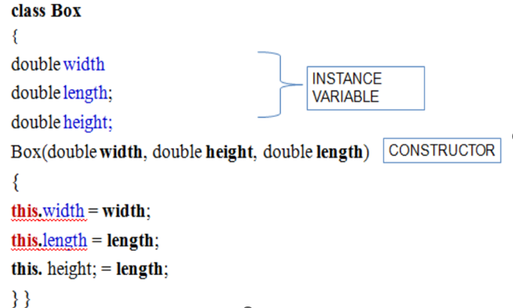
;
height;

Slide 43
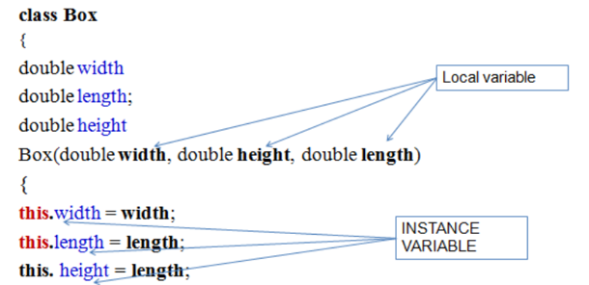

Slide 44
Method Overloading
It is possible to define two or more methods with same name within the same class, but their parameter declarations should be different.
This is called method overloading.
This is a form of polymorphism.
Overloaded methods must differ in the type and/or number of their parameters. (return types is not significant.)
When an overloaded method is invoked, Java uses the type and/or number of arguments to determine which version of the overloaded method to actually call.

Slide 45
Demonstrate method overloading
class Over{
void test(){
System.out.println("Empty");
}
void test(int a) {
System.out.println("a=" + a);
}
void test(int a, int b) {
System.out.println("a="+a);
System.out.println(“b="+b);
} }
class Sample {
public static void main(String args[])
{
Over ob = new Over();
ob.test();
ob.test(10);
ob.test(2, 5);
}}
Output
Empty
a=10
a=2
b=5

Slide 46
Here, test( ) is overloaded three times.
The first version test() takes no parameters,
the second test(int a)takes one integer parameter
the third test(int a,int b) takes two integer parameters.
When an overloaded method is called, Java looks for a match between the arguments used to call the method and the method's parameters
This match need not always be exact.
In some cases, Java's automatic type conversions can play a role in overload resolution.

Slide 47
Overloading -through automatic type conversions
class Over{
void test(){
System.out.println("Empty");
}
void test(double a) {
System.out.println("a=" + a);
}
}
class Sample {
public static void main(String args[])
{
Over ob = new Over();
ob.test();
ob.test(10);
ob.test(2.5);
}}
o/p
Empty
a=10.0
a=2.5

Slide 48
Overloading Constructors
Constructors can be overloaded.
A class can have any number of constructors
one default constructor, many parameterized constructors
class A{
A() { //statements}
A(int a) { //statements}
A(int a,float b) { //statements}
}

Slide 49
class Box{
double width;
double length;
double height;
Box(double w, double l,double h)
{
width = w;
length = l;
height = h;
}
Box(){
width = 0;
length =0;
height=0;
}}
class BoxDemo {
public static void main(String args[]) {
Box mybox1 = new Box();
Box mybox2 = new Box(3, 6, 2);
System.out.println( "mybox 1 ");
System.out.println(mybox1 .width +" "
+mybox1 .length + " "+ mybox1 .height);
System.out.println( "mybox2”);
System.out.println(mybox2.width + " " +mybox2.length + " " + mybox2 .height);
}}
Output
mybox 1
0.0 0.0
mybox2
3.0 6.0 2.0

Slide 50
class Box{
double width;
double length;
double height;
Box(double w, double l,double h){
this.width = w;
this.length = l;
this.height = h;
}}
class BoxDemo {
public static void main(String args[]) {
Box mybox1 = new Box(); //ERROR
Box mybox2 = new Box(3, 6, 2);
} }
Box class has constructor but no default constructor is there. So error occurs

Slide 51
Using Objects as Parameters
We can pass objects as arguments to method
Objects are passed by reference(call by reference).

Slide 52
class Test {
int a, b;
Test(int i, int j){
a=i;
b=j;
}
boolean equals(Test o){
if(o.a== a && o.b== b)
return true;
else return false;
}}
class PassOb {
public static void main(String args[]){
Test ob1 = new Test(100, 22);
Test ob2 = new Test(100, 22);
Test ob3 = new Test(-l,-1);
System.out.println(ob1.equals(ob2));
System.out.println(ob1.equals(ob3));
}}
o/p
true
false

Slide 53
Object to initialize another object
class Box
{
double width
double length;
double height;
}
Box(double w, double l, double h)
{
width = w
length = l;
height = h;
}
class BoxDemo
{
public static void main(String args[])
Box bl = new Box(10, 20, 15);
Box b2 = new Box(bl);
}
}
The object b2 is initialized using initial values of object b1

